Slide 1

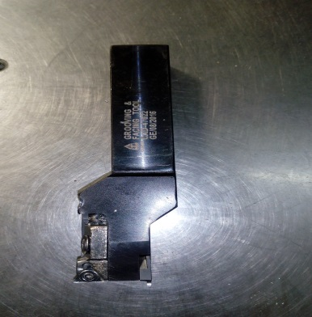
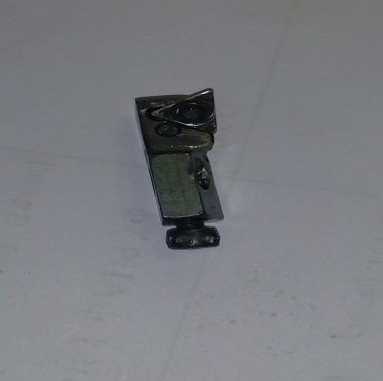
P15
TPM CIRCLE NO :-
ACTIVITY
KK
QM
PM
JH
SHE
OT
DM
E&T
KAIZEN IDEA SHEET
TPM CIRCLE NAME:
LOSS NO. / STEP
DEPT :- Machine Shop
RESULT AREA
P
Q
A
C
D
S
M
CELL:-Machine shop
CELL NAME:-Tensioner
MACHINE / STAGE :- CNC - 006
OPERATION :-Facing & Growing
KAIZEN THEME: To eliminate excess tool set up time
IDEA :. To use two separate tool which insert in machine at one time
COUNTERMEASURE: Two tool insert in machine at one time A157 – 0.8 grid & A319 – 0.4 grid
BENCHMARK
60 Min
Problem present status : More set up time A157 & A319.
TARGET
0 Min
KAIZEN START
24.12.2016
KAIZEN FINISH
2.1.2017
Two deferent cartage use in one which required to change as change job
TEAM MEMBERS: Vinod Jadhav, Walunj ,
Amol Kokate
BENEFITS : 1) Save set up time
2) Reduce rejection
3) Increases production
Before
After
KAIZEN SUSTENANCE
WHY - WHY ANALYSIS :-
Tool change as per change job
2) Require deferent insert grid job ( A157-0.8, & A319-0.4
3) New two tool improve
RESULT :-
1) Save set up time
2) Reduce rejection
3) Increases production
WHAT TO DO:- Reduce set up time
HOW TO DO:- Insert two tool in machine
FREQUENCY :-
ROOT CAUSE : New tool to be improve
REGISTRATION NO. & DATE:-24.12.2016
SCOPE & PLAN FOR HORIZONTAL DEPLOYMENT
REGISTERED BY :- Vinod Jadhav
SR.
NO.
CELL
TARGET
RESPONSIBILITY
STATUS
MANAGER’S SIGN :- DY.P
1
CNC-02
30 feb 2017
Vinod Jadhav
In process

